Slide 1


Chua Han Xian
30 Dec 24

Slide 2

Outline
Executive Summary
Introduction
Methodology
Results
Conclusion
Appendix

Slide 3
Executive Summary
Summary of methodologies
Data collection through API.
Data wrangling.
EDA with SQLite.
EDA with data visualization.
Interactive Dashboard with Folium.
ML prediction.
Summary of all results
EDA results.
Interactive Screenshots
Predictive results.

Slide 4
Introduction
Project background and context
Space X advertises Falcon 9 rocket launches on its website with a cost of 62 million dollars; other providers cost upward of 165 million dollars each, much of the savings is because Space X can reuse the first stage. Therefore, if we can determine if the first stage will land, we can determine the cost of a launch. This information can be used if an alternate company wants to bid against space X for a rocket launch. This goal of the project is to create a machine learning pipeline to predict if the first stage will land successfully.
Problems you want to find answers
What factors determine if the rocket will land successfully?
The interaction amongst various features that determine the success rate of a successful landing.
What operating conditions needs to be in place to ensure a successful landing program.

Slide 5

Section 1

Slide 6
Methodology
Executive Summary
Data collection methodology:
Data was collected using SpaceX API and web scraping from Wikipedia.
Perform data wrangling
New feature creation (‘Class’) and feature encoding for categorical features.
Perform exploratory data analysis (EDA) using visualization and SQL
Perform interactive visual analytics using Folium and Plotly Dash
Perform predictive analysis using classification models
How to build, hyperparameter tuning, evaluate classification models.

Slide 7
Data Collection
The data was collected using various methods
Data retrieval involves sending GET request to the SpaceX API.
The API response was decoded as JSON using .JSON() function, then transformed into pandas dataframe using .json_normalize().
Subsequently, the data was cleaned by checking for missing values and addressing where necessary.
Additionally, web scraping was conducted using BeautifulSoup to extract Falcon 9 launch records from wikipedia, converting the parsed HTML table into pandas dataframe.
https://github.com/Pipbytes/IBM-Data-Science-Capstone-SpaceX/blob/main/SpaceX%20%20classification%20prediction/01a-spacex-data-collection-api-v2.ipynb

Slide 8
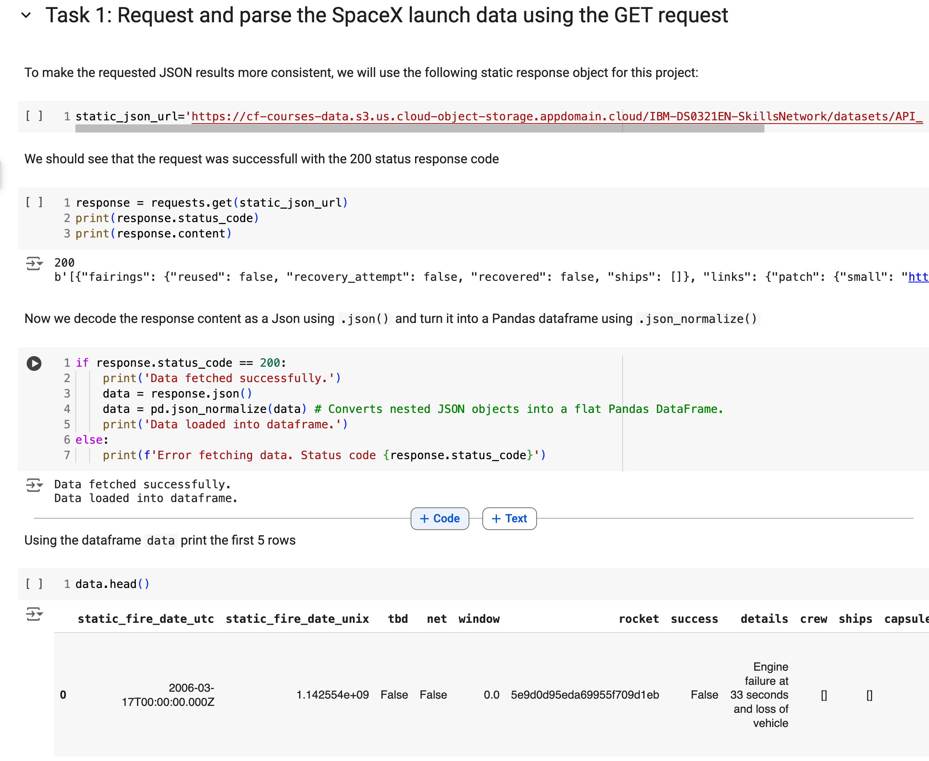
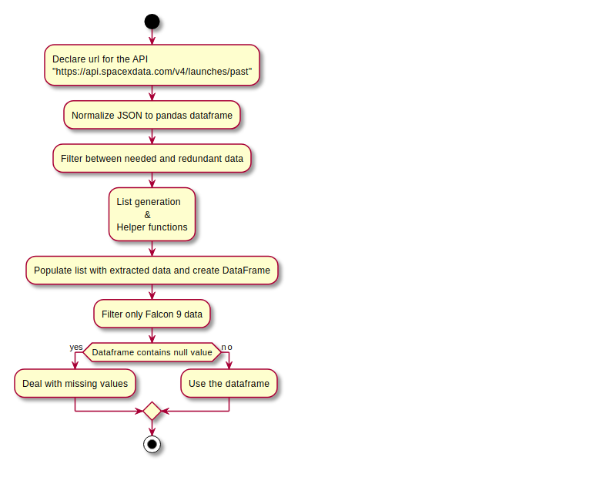
Data Collection – SpaceX API
A REST API call using a static JSON url.
Fetching and decoding JSON data into pandas dataframe.
Status code check and process logic.
Diplay dataframe.
Place your flowchart of SpaceX API calls here

Slide 9
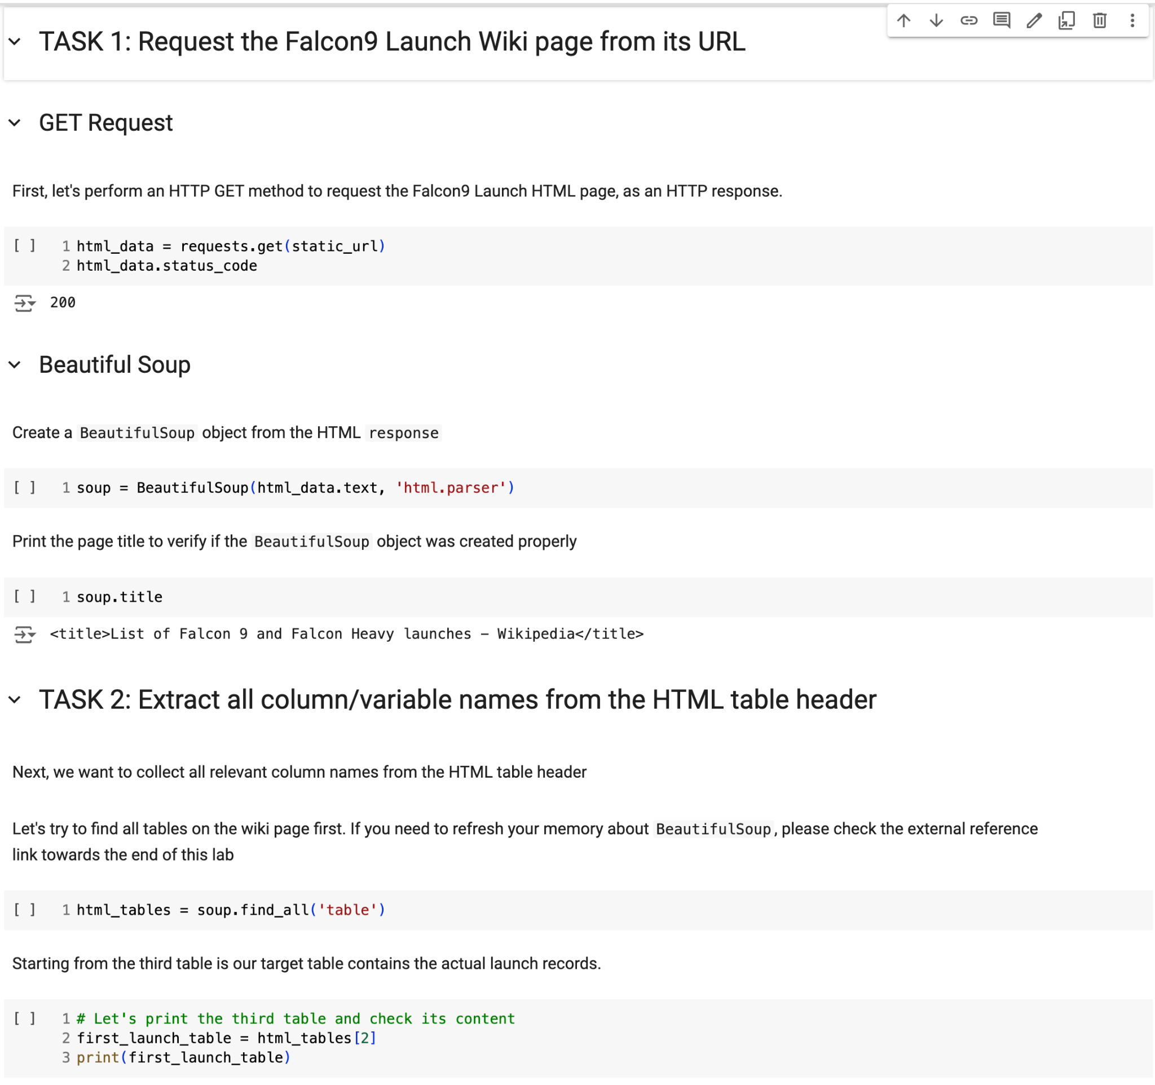
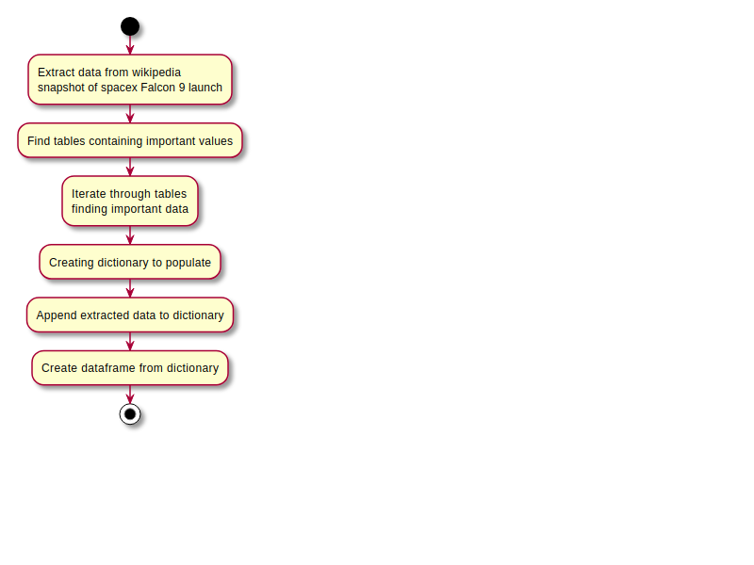
Data Collection - Scraping
Making a GET requrest to retrieve Falcon9 launch wikipidia page.
Using beautiful soup to parse HTML response.
Extracting and indentifying tables in HTML content.
Print and verify target table for data extraction.
https://github.com/Pipbytes/IBM-Data-Science-Capstone-SpaceX/blob/main/SpaceX%20%20classification%20prediction/01b-spacex-data-collection-webscraping.ipynb
Place your flowchart of web scraping here

Slide 10
Data Wrangling
Identified the percentage of missing values for each features.
Identified features which are numerical and categorical.
Calculated the number of launches for each site, and occurrence of each orbit type.
Create a new landing outcome label from the outcome column.
Exported the results to csv.
https://github.com/Pipbytes/IBM-Data-Science-Capstone-SpaceX/blob/main/SpaceX%20%20classification%20prediction/02-spacex-Data%20wrangling-v2.ipynb

Slide 11
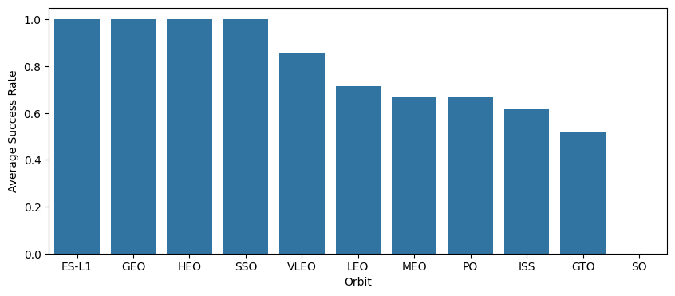
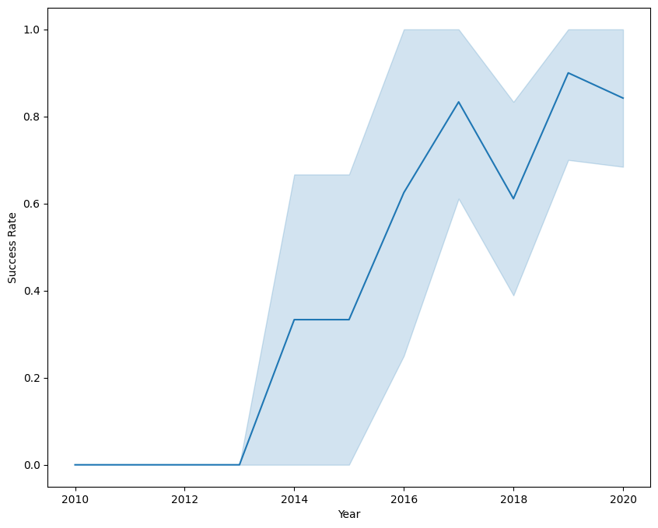
EDA with Data Visualization
Explored the data by visualizing the relationship between flight numbers, payload mass, launch site, and orbit type using scatterplots.
Use bar chart to rank the success rate of each orbit type, and line chart to plot the yearly success trends.
https://github.com/Pipbytes/IBM-Data-Science-Capstone-SpaceX/blob/main/SpaceX%20%20classification%20prediction/03b-spacex-eda-dataviz-v2.ipynb

Slide 12
EDA with SQL
Loaded SpaceX dataset into SQL lite3 database directly from jupyter notebook environment.
Use SQL query for EDA, and derived valuable insights such as:
Identify the unique launch site names used in space missions.
Calculate the total payload mass carried by NASA (CRS) boosters.
Determine the average payload mass for booster version F9 v1.1.
Count the total number of successful and failed mission outcomes.
Listing the failed landing outcomes on drone ships, including the associated booster version and launch site names.
https://github.com/Pipbytes/IBM-Data-Science-Capstone-SpaceX/blob/main/SpaceX%20%20classification%20prediction/03a-spacex-eda-sqllite.ipynb

Slide 13
Build an Interactive Map with Folium
We identified and marked all launch sites on the map and incorporated elements like markers, circles, and lines to indicate the success or failure of launches at each site using Folium library.
Launch outcomes were categorized as class 0 for failures and class 1 for successes to enable analysis.
By enabling color-coded analysis marker clusters, we are able to determine which launch sites exhibited higher success rate.
We measure the distance from each launch site to nearby features and addressed the questions such as:
Are the launch sites located to railways, highways, and coastlines?
Do launch sites maintain a specific distance from urban areas?

Slide 14
Build a Dashboard with Plotly Dash
Created an interactive dashboard using Plotly for dynamic data visualization.
Displayed pie charts to illustrate the total number of launches at each site.
Visualized the relationship between launch outcomes and payload mass (kg) across different booster versions using scatterplots.
https://github.com/Pipbytes/IBM-Data-Science-Capstone-SpaceX/blob/main/SpaceX%20%20classification%20prediction/04b-spacex-dashboard-ploty-v2.ipynb

Slide 15
Predictive Analysis (Classification)
Loaded and transformed data using numpy and pandas, then split into training and testing datasets.
Developed multiple machine learning models and optimized their performance using GridSearchCV for hyperparameter tuning.
Evaluated model performance using accuracy as the primary metric and enhanced results through feature engineering and algorithm tuning.
Identified the best performing classification model.
https://github.com/Pipbytes/IBM-Data-Science-Capstone-SpaceX/blob/main/SpaceX%20%20classification%20prediction/05-spacex-Machine-Learning-Prediction-v1.ipynb

Slide 16
Results
Exploratory data analysis results
Interactive analytics demo in screenshots
Predictive analysis results

Slide 17

Section 2

Slide 18
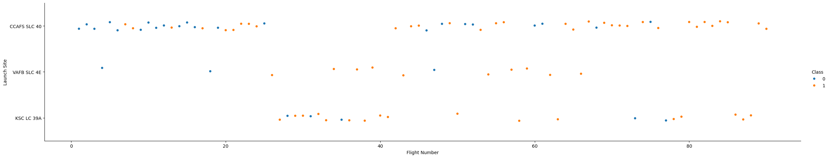
Flight Number vs. Launch Site
The overall success rate appears to improve as flight number increases, indicating learning or operational improvements over time.
Different launch sites have varying levels of reliability, with CCAFS SLC-40 and KSC LC-39A showing better performance trends compared to VAFB SLC-4E.

Slide 19
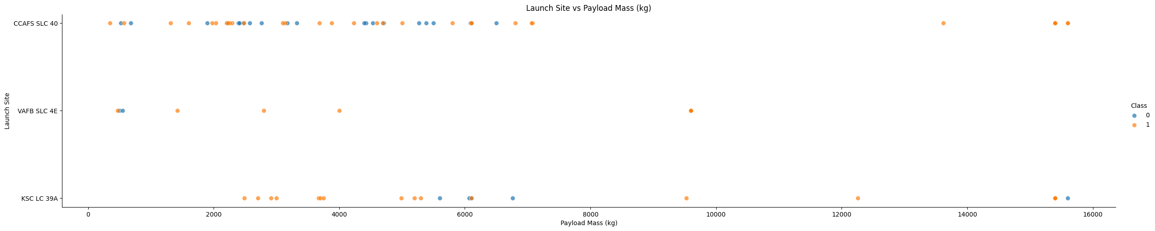
Payload vs. Launch Site
Higher payloads are handled successfully, especially at CCFAS SLC40, suggesting that the site's infrastructure and technology are optimized for heavier payloads.
In contrast, there are more failures with lower payload, suggesting handling or site-specific constraints.

Slide 20
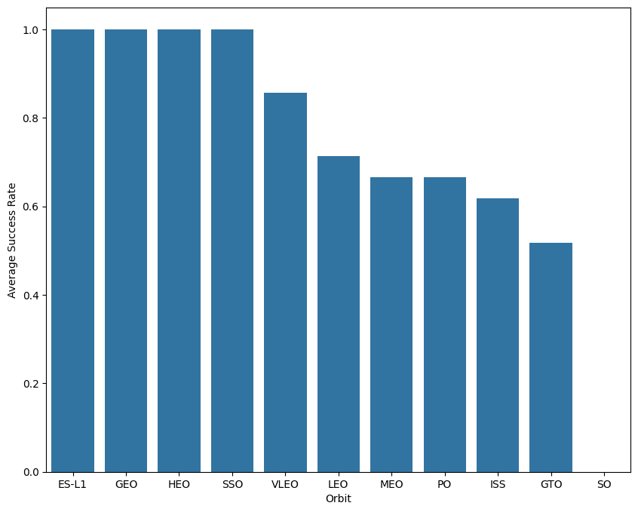
Success Rate vs. Orbit Type
From the plot, we can see that ES-L1, GEO, HEO, SSO, and VLEO had the most success rate.

Slide 21
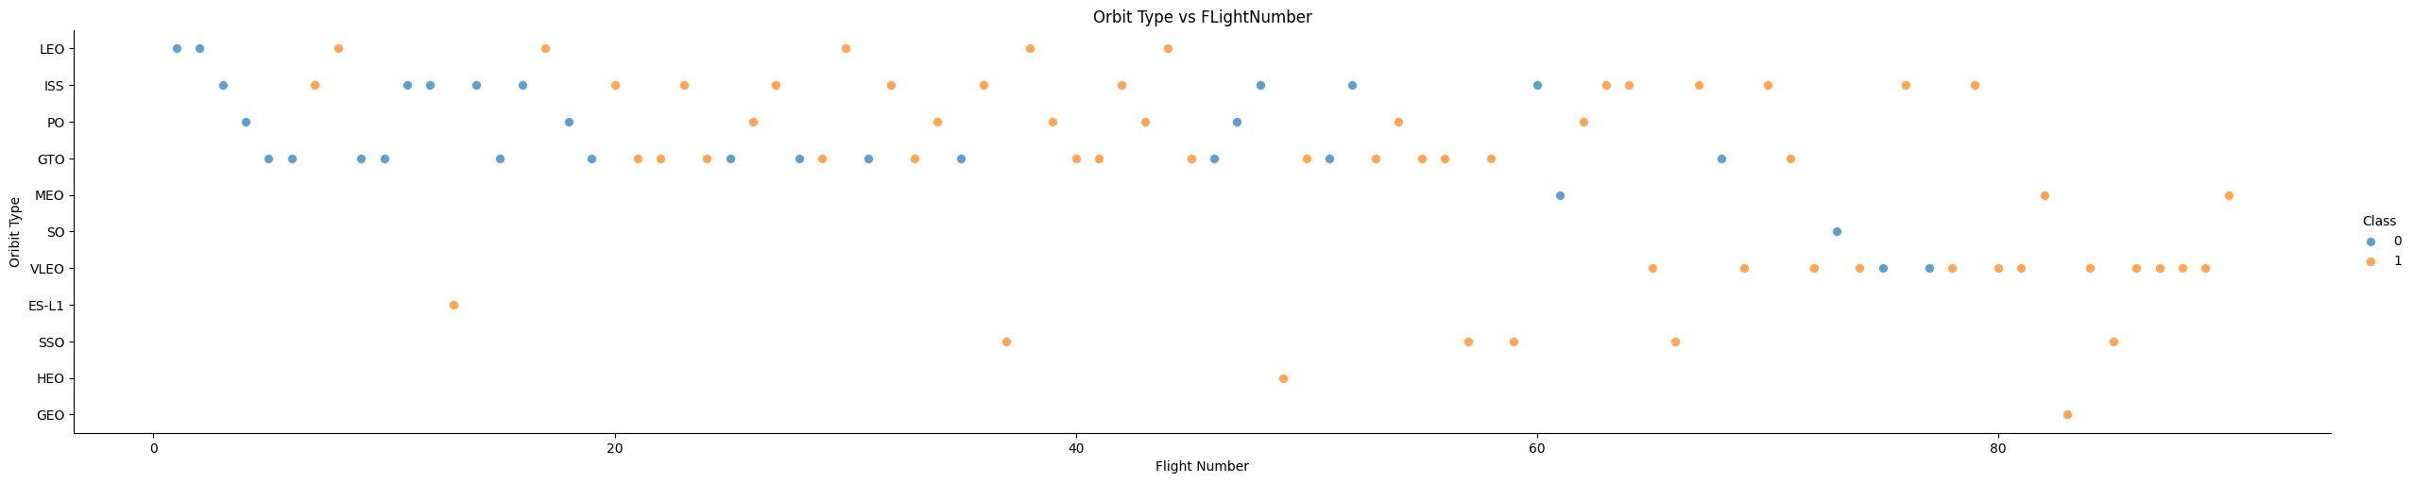
Flight Number vs. Orbit Type
The plot below shows the Flight Number vs. Orbit type. We observe that in the LEO orbit, success is related to the number of flights whereas in the GTO orbit, there is no relationship between flight number and the orbit.

Slide 22
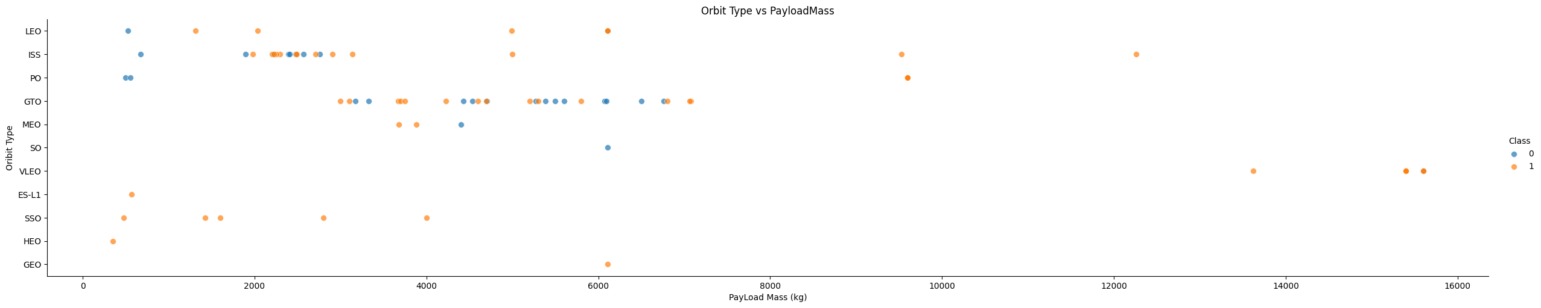
Payload vs. Orbit Type
We can observe that with heavy payloads, the successful landing are more for PO, LEO and ISS orbits.

Slide 23
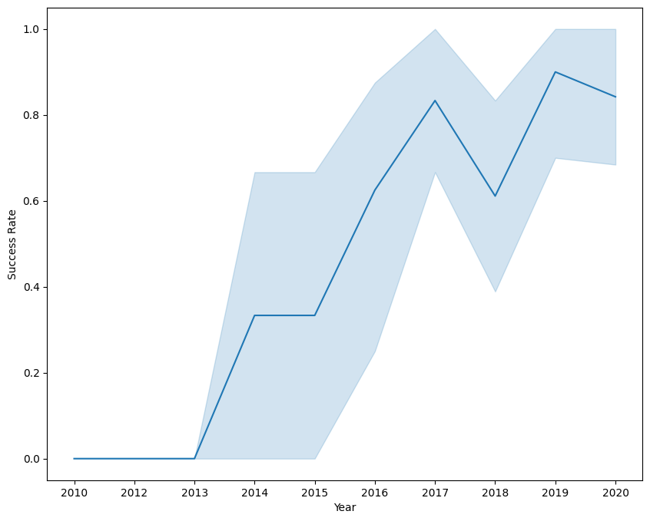
Launch Success Yearly Trend
You can observe that the success rate since 2013 kept increasing till 2017 (stable in 2014) and after 2015 it started increasing.

Slide 24
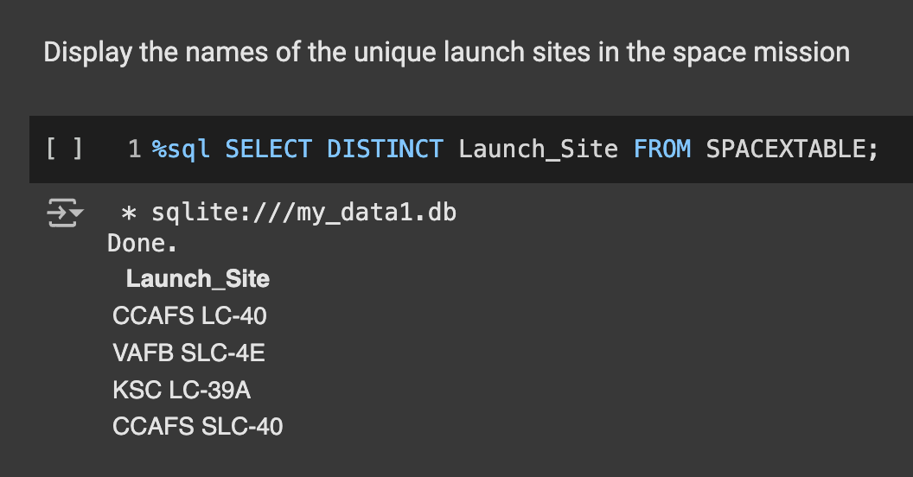
All Launch Site Names
Find the names of the unique launch sites
Present your query result with a short explanation here

Slide 25
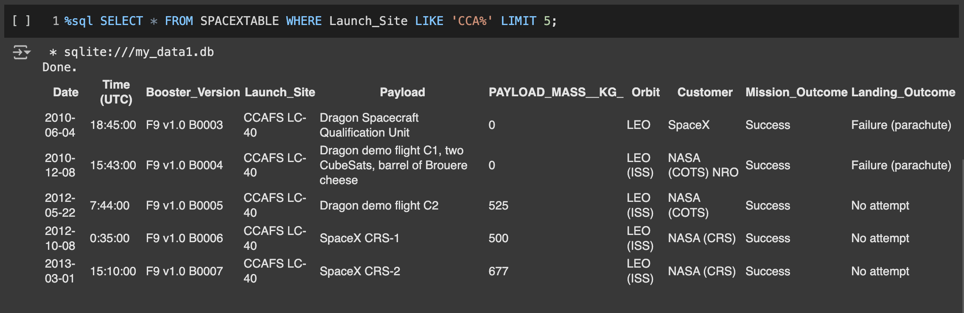
Launch Site Names Begin with 'CCA'
Find 5 records where launch sites begin with `CCA`
Present your query result with a short explanation here

Slide 26
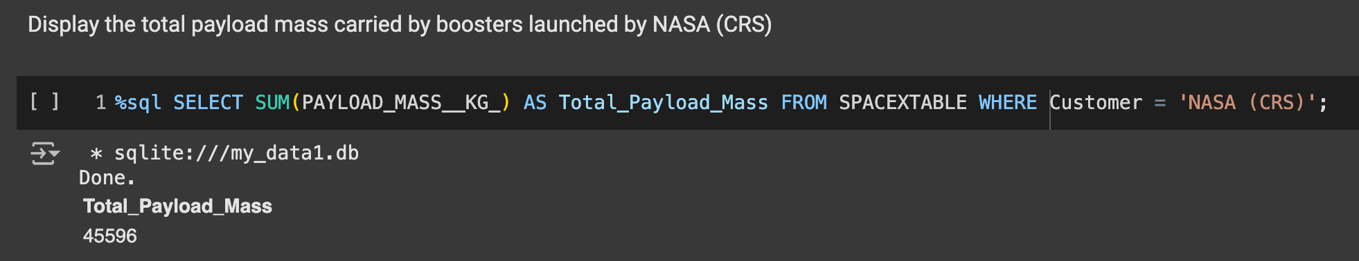
Total Payload Mass
Calculate the total payload carried by boosters from NASA
Present your query result with a short explanation here

Slide 27
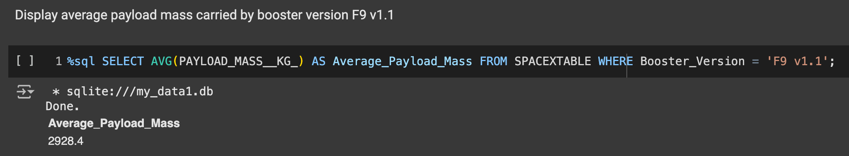
Average Payload Mass by F9 v1.1
Calculate the average payload mass carried by booster version F9 v1.1
Present your query result with a short explanation here

Slide 28
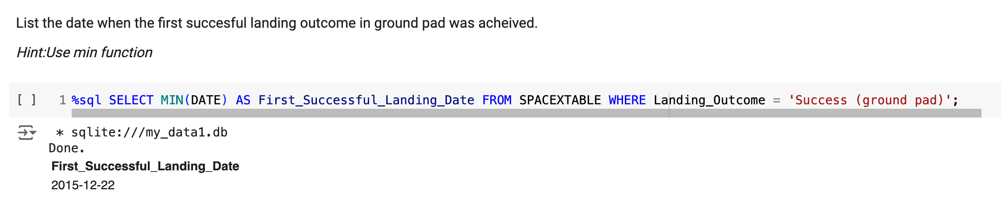
First Successful Ground Landing Date
Find the dates of the first successful landing outcome on ground pad
Present your query result with a short explanation here

Slide 29
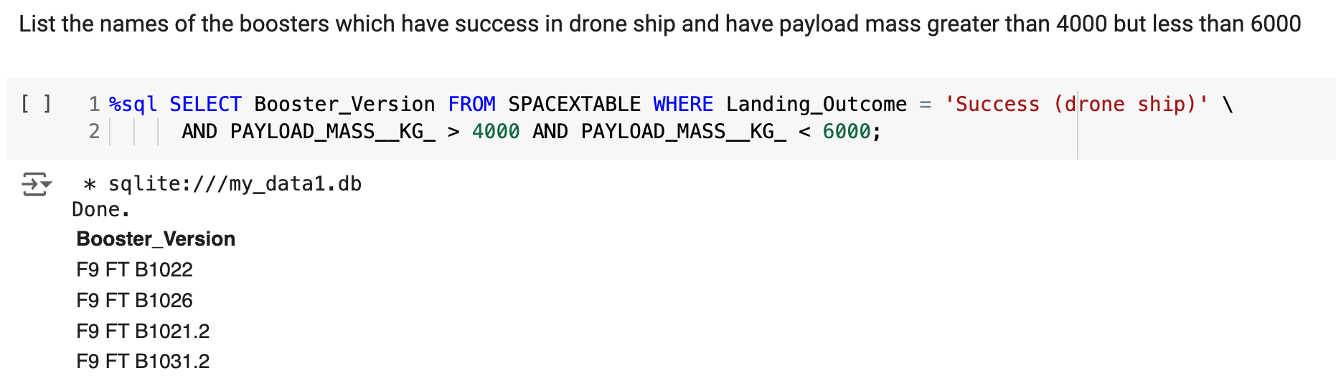
Successful Drone Ship Landing with Payload between 4000 and 6000
List the names of boosters which have successfully landed on drone ship and had payload mass greater than 4000 but less than 6000
Present your query result with a short explanation here

Slide 30
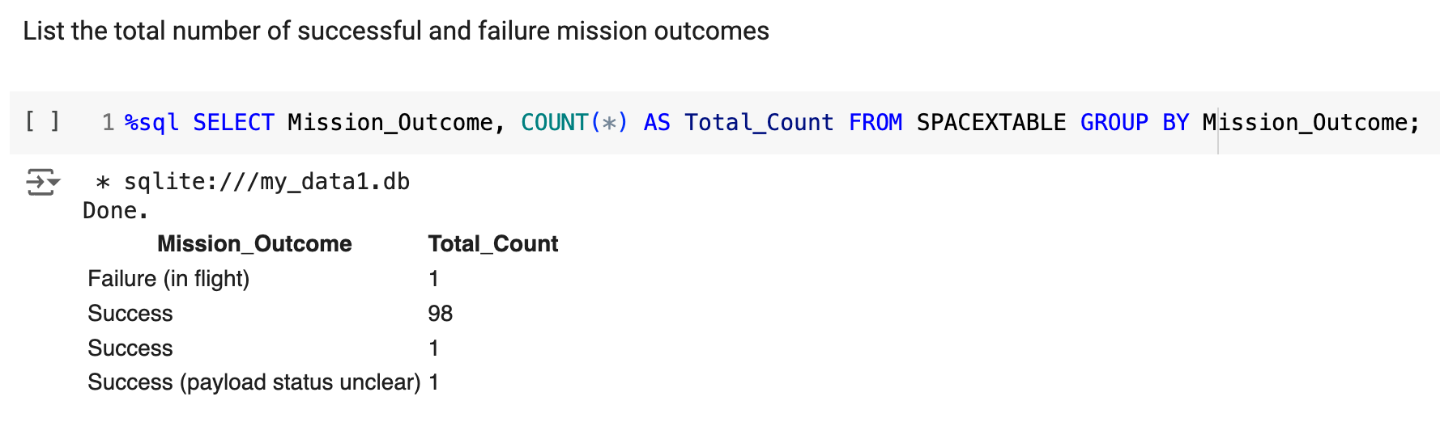
Total Number of Successful and Failure Mission Outcomes
Calculate the total number of successful and failure mission outcomes
Present your query result with a short explanation here

Slide 31
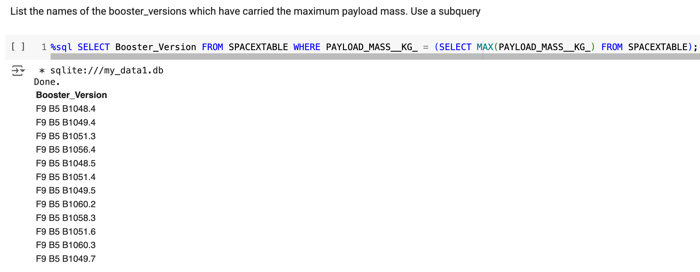
Boosters Carried Maximum Payload
List the names of the booster which have carried the maximum payload mass
Present your query result with a short explanation here

Slide 32
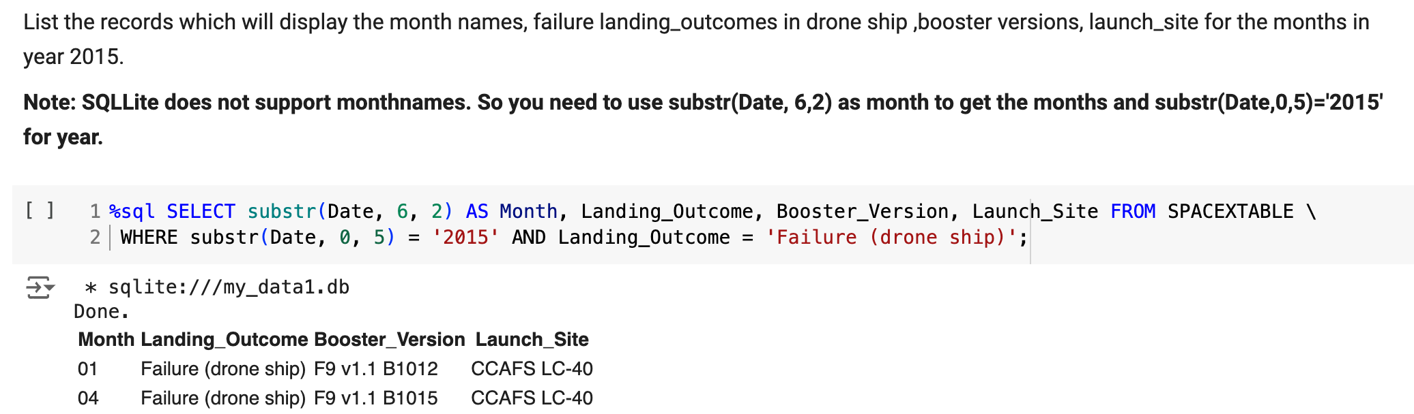
2015 Launch Records
List the failed landing_outcomes in drone ship, their booster versions, and launch site names for in year 2015
Present your query result with a short explanation here

Slide 33
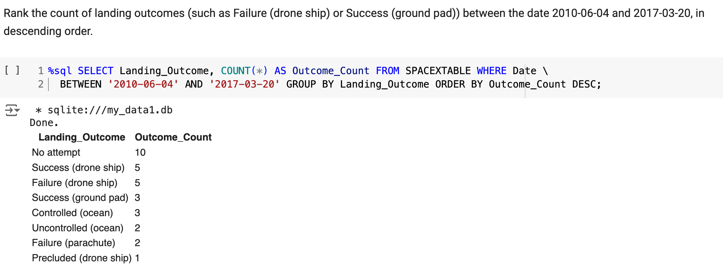
Rank Landing Outcomes Between 2010-06-04 and 2017-03-20
Rank the count of landing outcomes (such as Failure (drone ship) or Success (ground pad)) between the date 2010-06-04 and 2017-03-20, in descending order
Present your query result with a short explanation here

Slide 34

Section 3

Slide 35
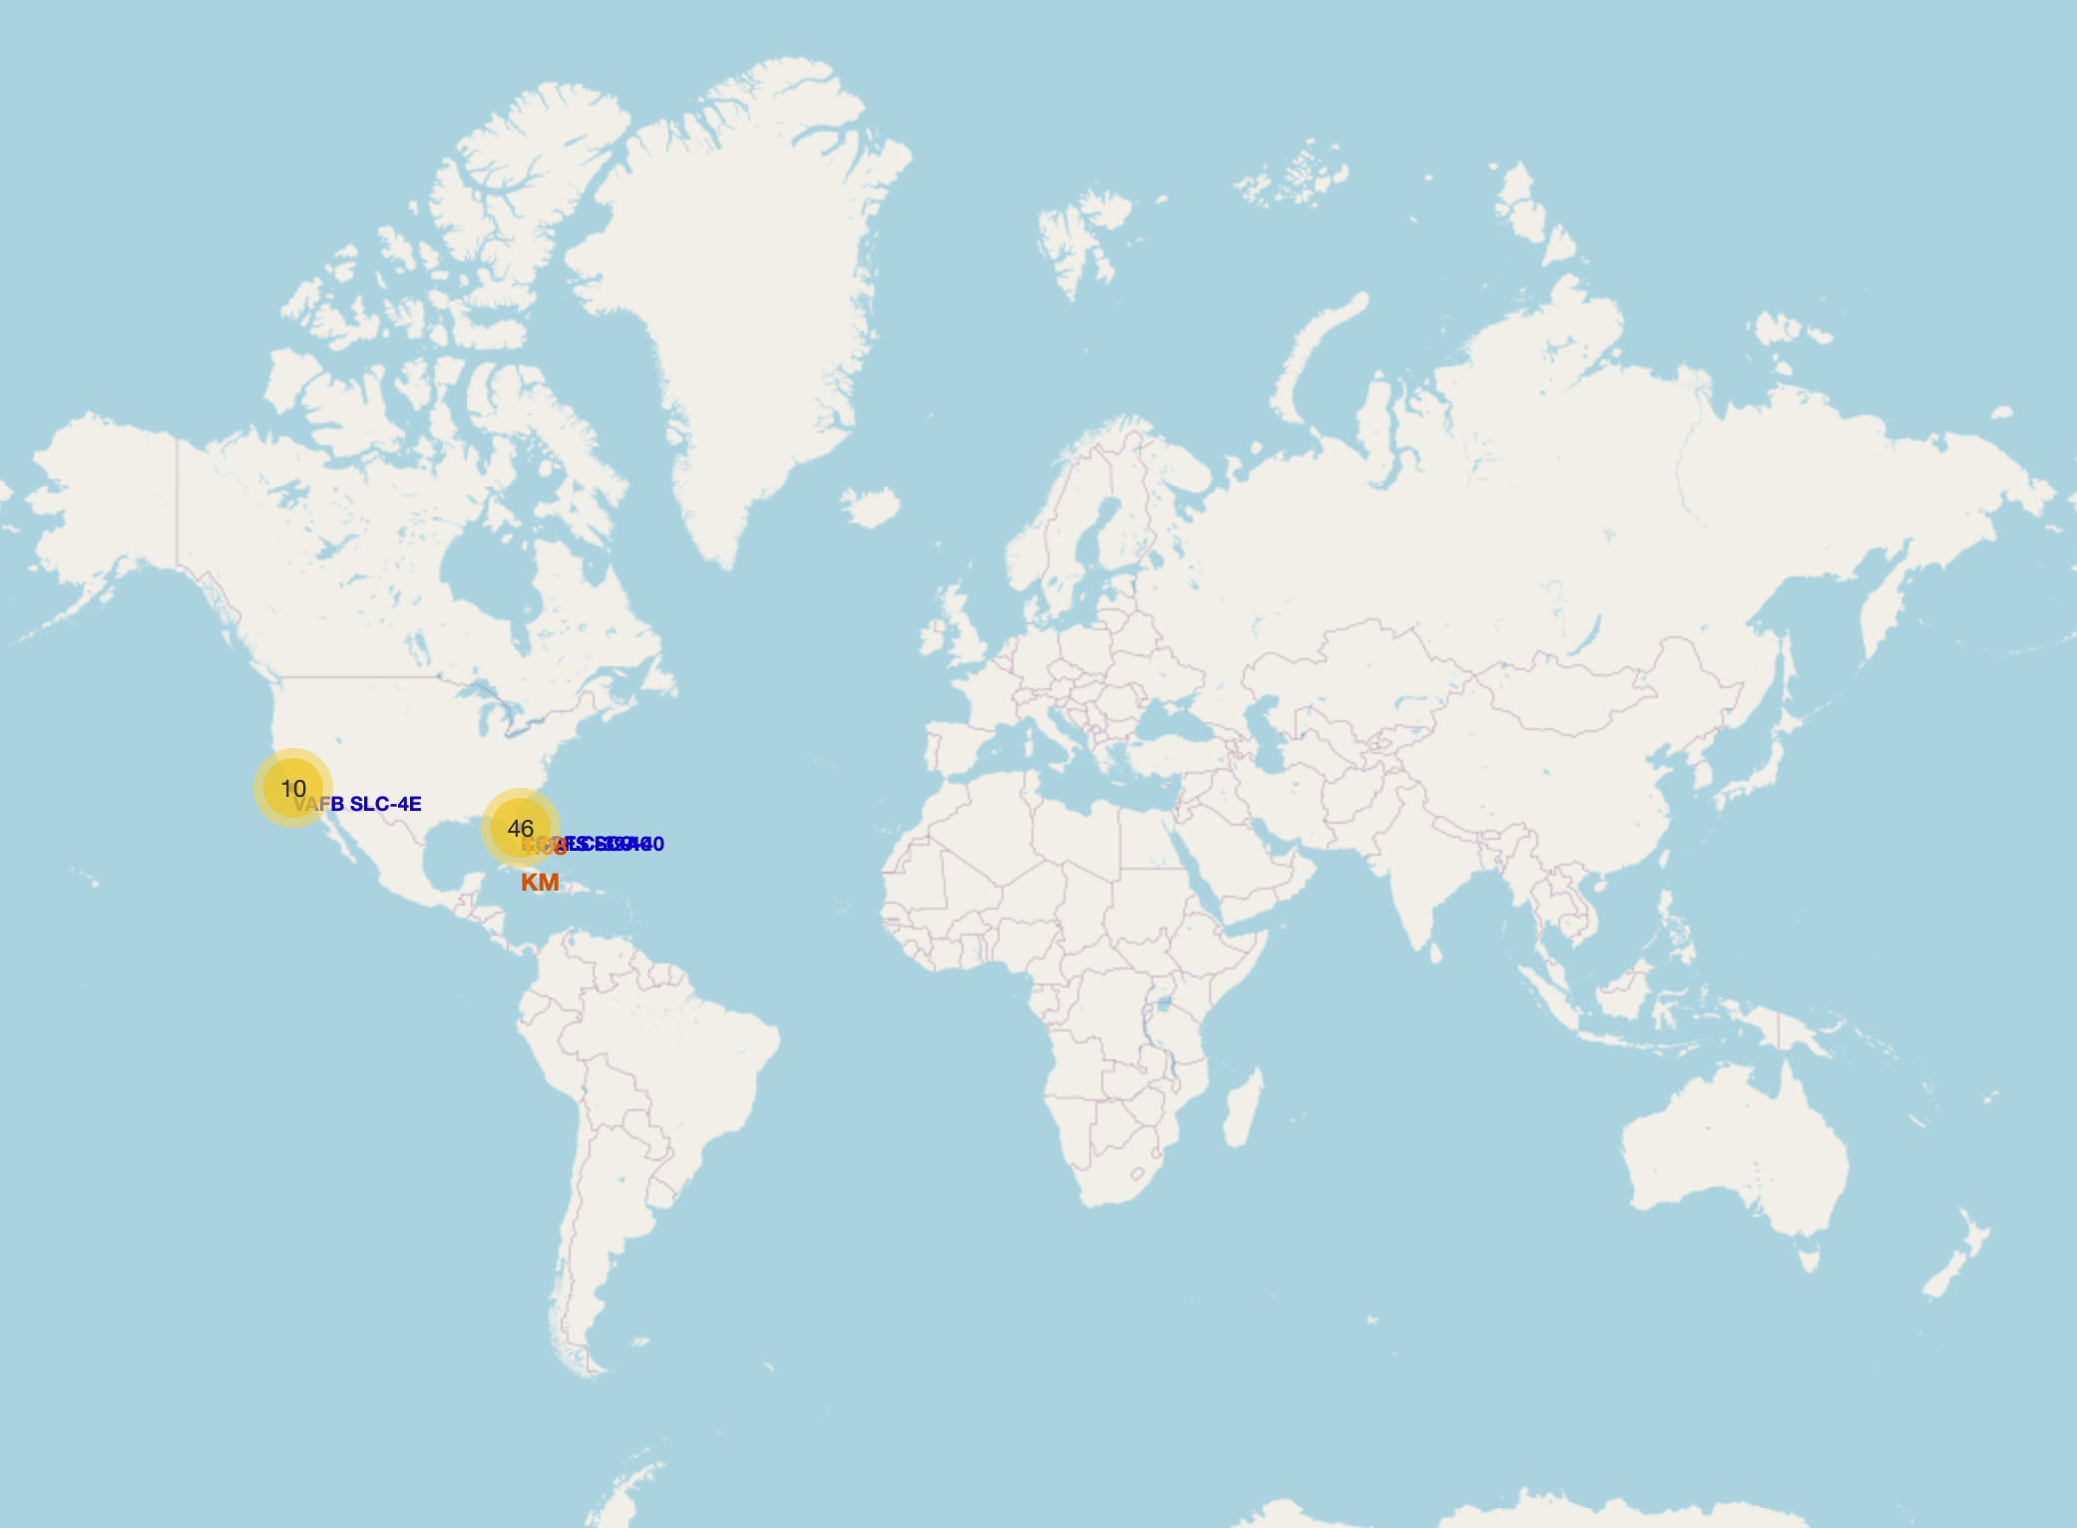
All launch sites global map markers
Replace <Folium map screenshot 1> title with an appropriate title
Explore the generated folium map and make a proper screenshot to include all launch sites’ location markers on a global map
Explain the important elements and findings on the screenshot

Slide 36
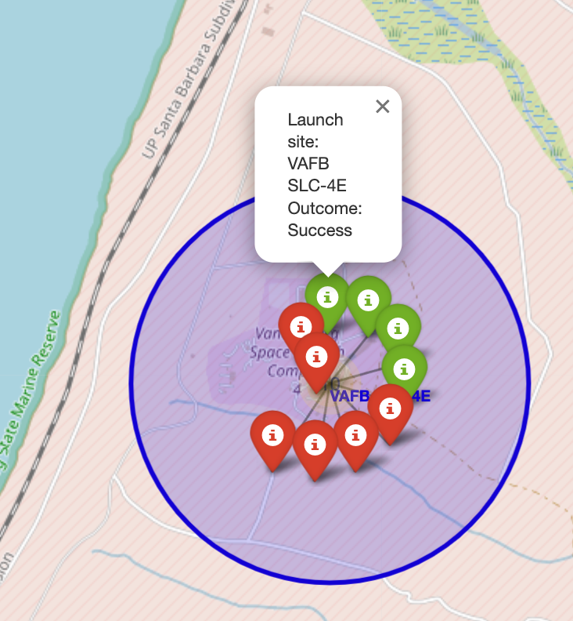
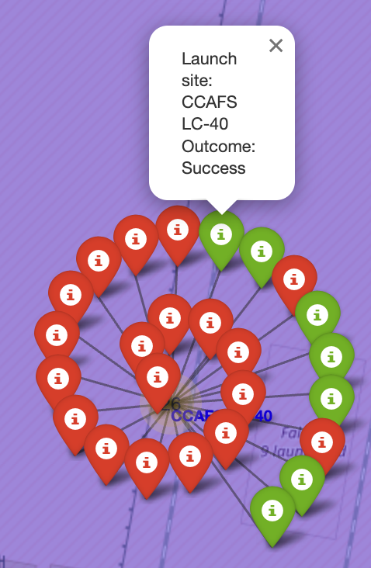
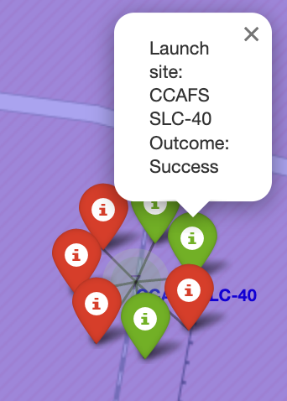
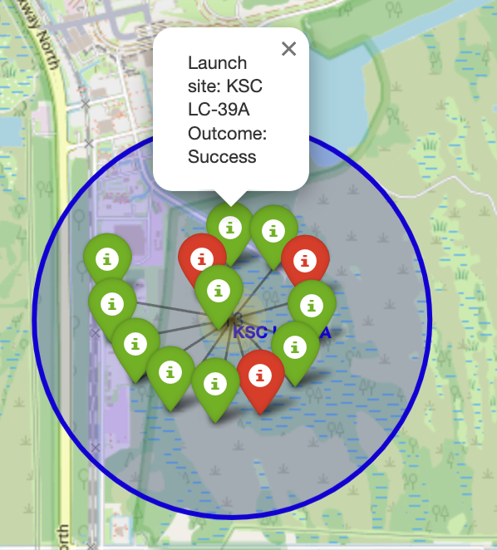
Markers showing launch sites with color labels
Green markers indicate successful launches and Red markers show failure.

Slide 37
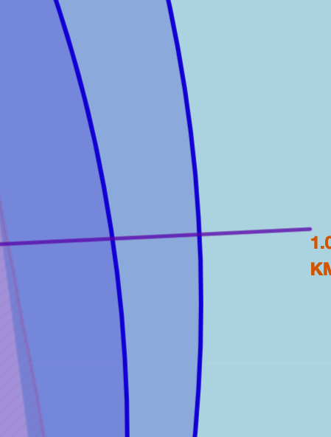
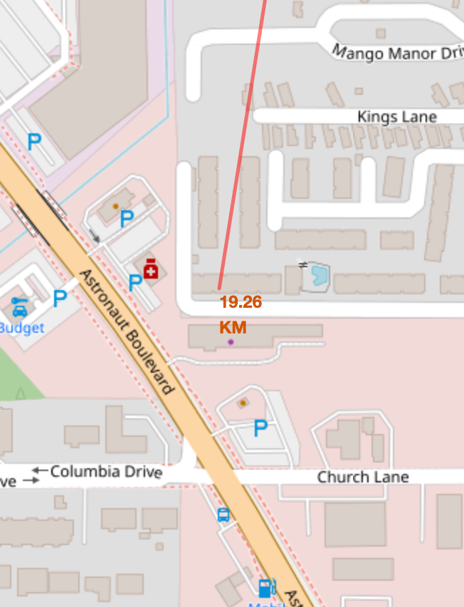
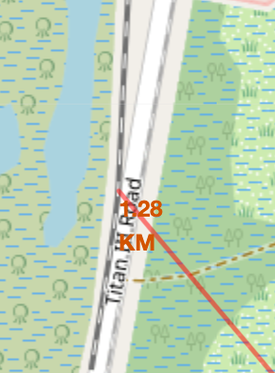
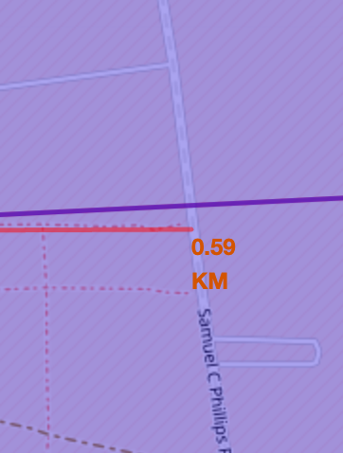
Markers showing launch sites with color labels
Distances to Coastline (1.09km), City (19.3km), Railway (1.28km), Highway (0.59km)

Slide 38

Section 4

Slide 39
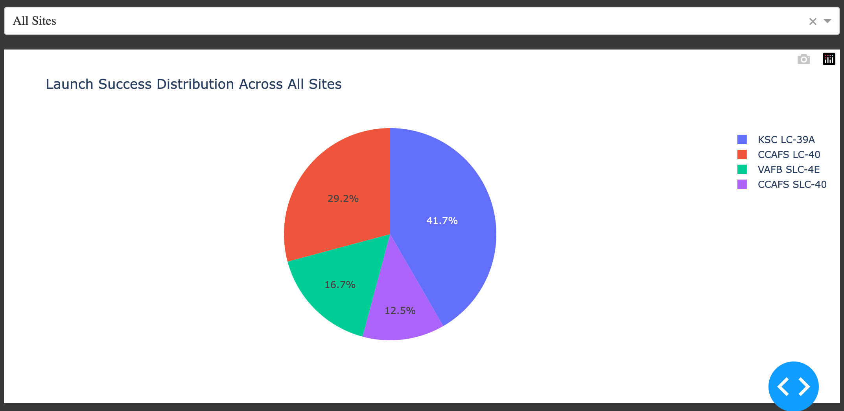
Pie chart of successful launches by each launch sites
Replace <Dashboard screenshot 1> title with an appropriate title
Show the screenshot of launch success count for all sites, in a piechart
Explain the important elements and findings on the screenshot

Slide 40
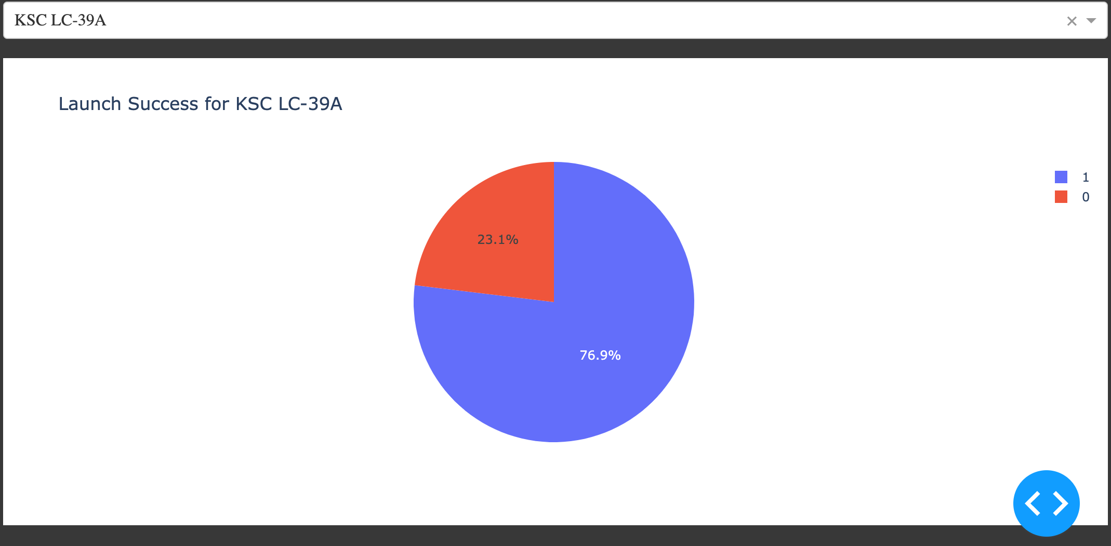
Pie chart of launch site with highest successful rate
Replace <Dashboard screenshot 2> title with an appropriate title
Show the screenshot of the piechart for the launch site with highest launch success ratio
Explain the important elements and findings on the screenshot

Slide 41
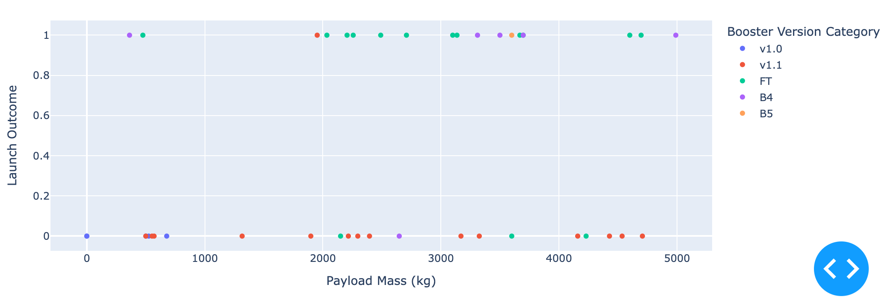
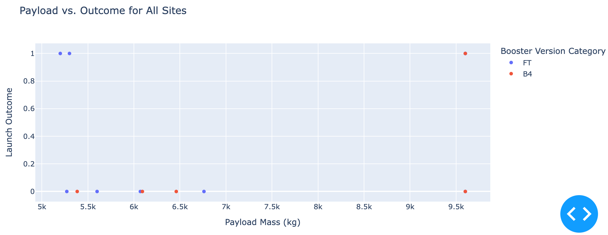
Pie chart of launch site with highest successful rate
Low weighted payload
(<=4000kg)
Heavy weighted payload
4000 < x <= 10000kg

Slide 42

Section 5

Slide 43
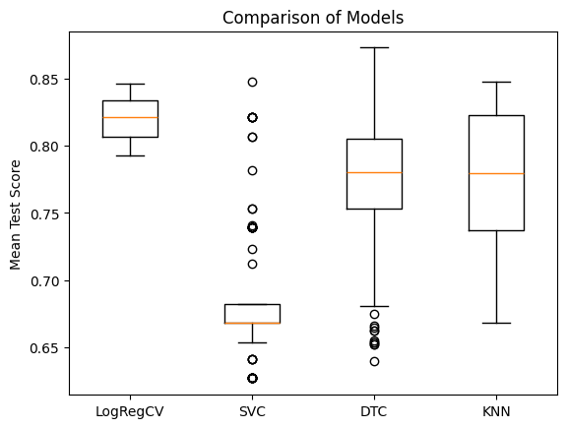
Classification Accuracy
Logistic Regression has the highest mean test score.

Slide 44

Confusion Matrix
The confusion matrix shows that the logistic regression model correctly predicted 12 "landed" outcomes and 3 "did not land" outcomes, while misclassifying 3 "did not land" cases as "landed." The overall performance indicates strong accuracy, but there is room for improvement in predicting non-landings.

Slide 45
Conclusions
We can conclude that:
Launch success rate started to increase in 2013 till 2020.
Orbits ES-L1, GEO, HEO, SSO, VLEO had the most success rate.
KSC LC-39A had the most successful launches of any sites.
The Decision tree classifier is the best machine learning algorithm for this task.
The larger the flight amount at a launch site, the greater the success rate at a launch site.

Slide 46


